Slide 1
Beating leprosy, breaking stigma and building lives.
NLT serves in areas of Nepal where leprosy is still prevalent. Our vision is to help eradicate leprosy; to overcome prejudice against those affected, and to improve people’s standard of living.

Slide 2
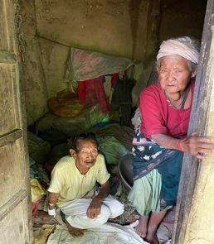
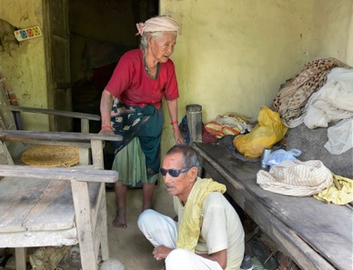
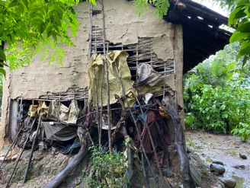
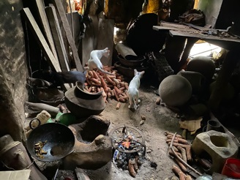
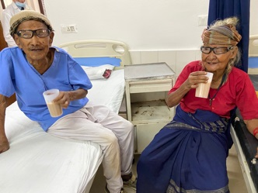
Marichmann and Radika Maya

Slide 3
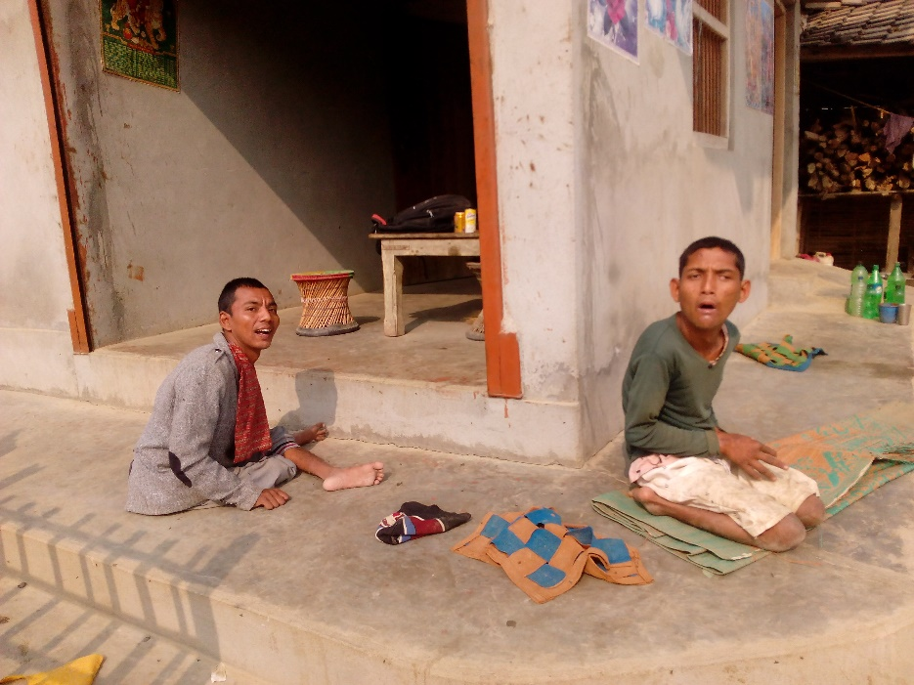
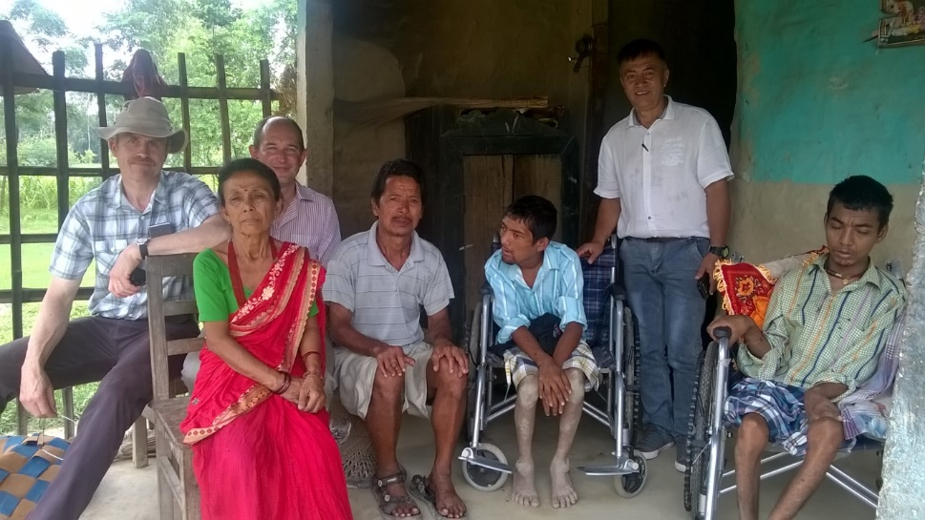
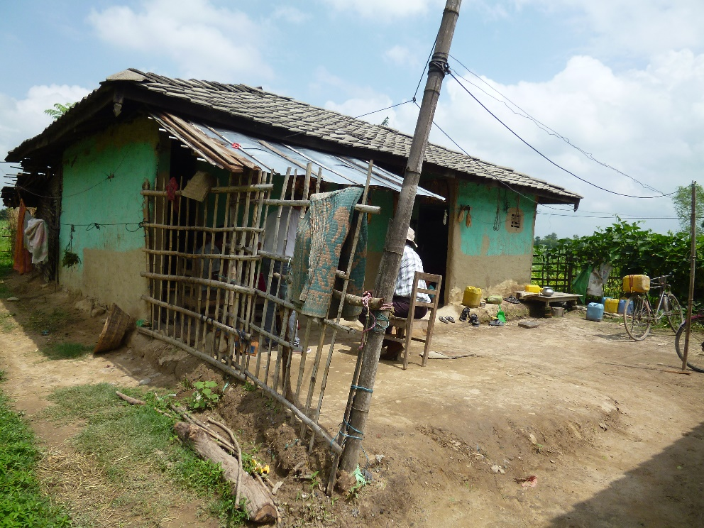
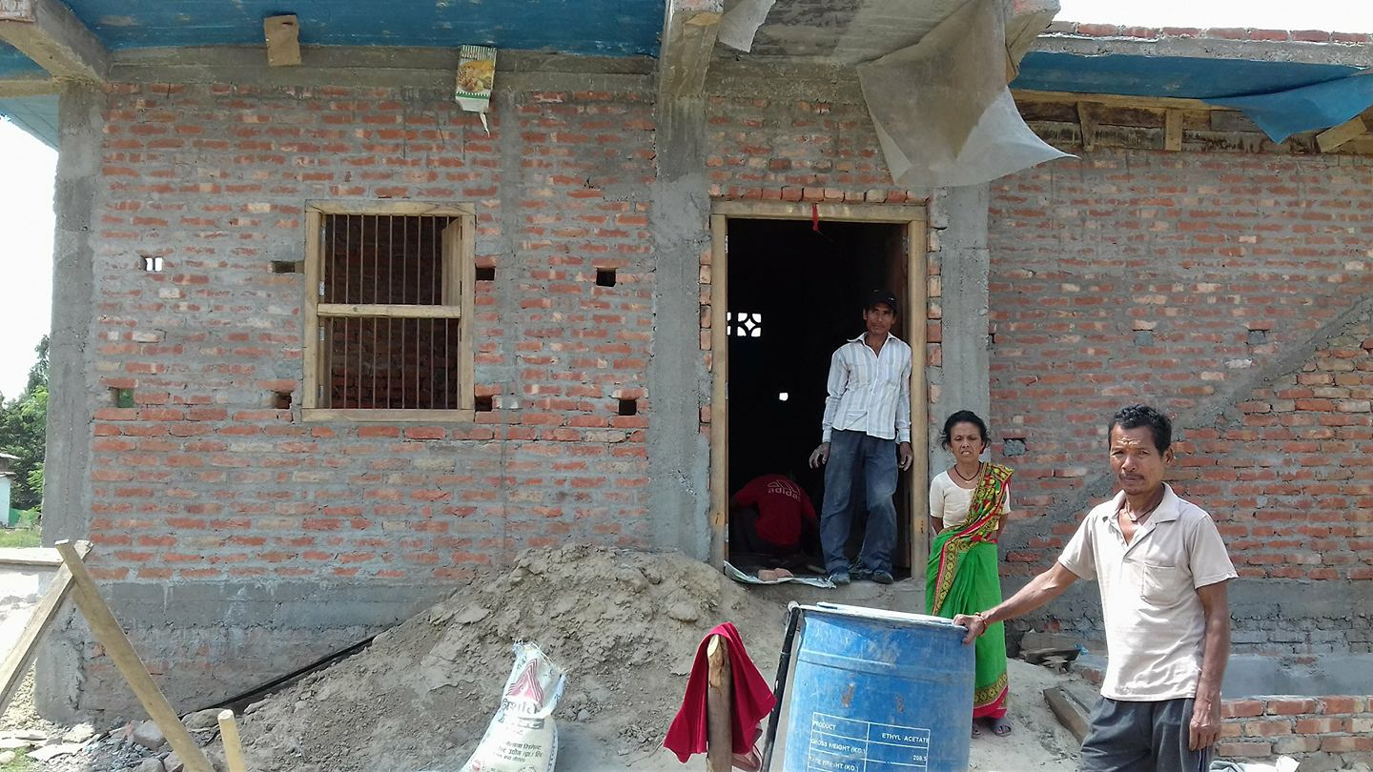
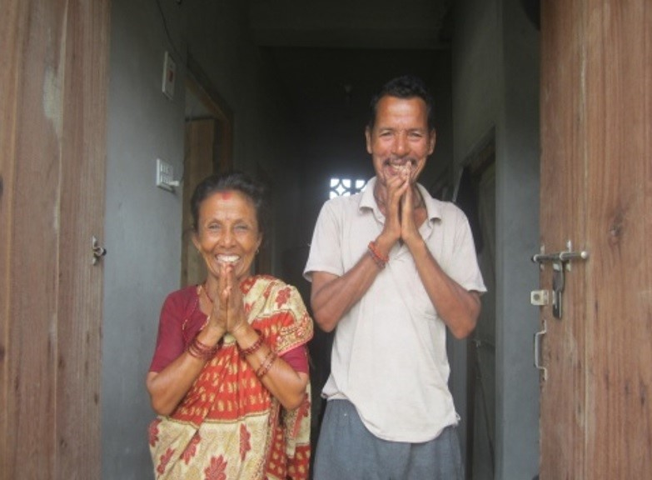
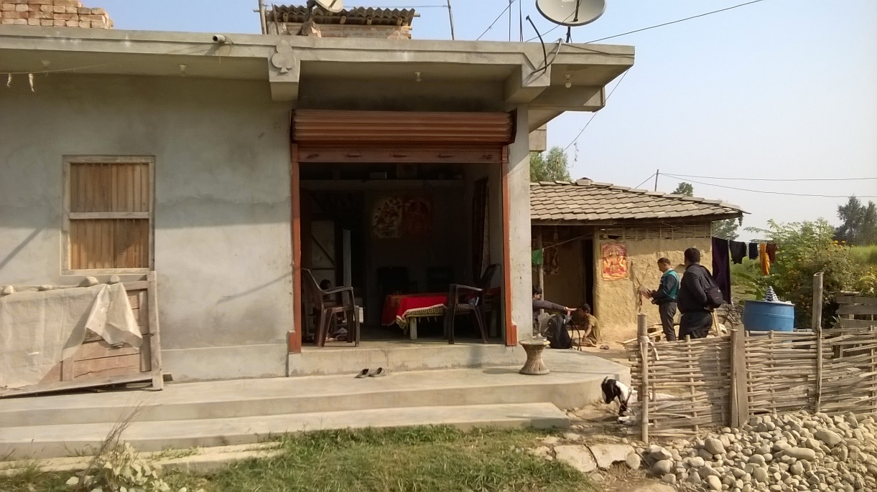
Badri Shrestha with Samwati, Subash and Sudip

Slide 4
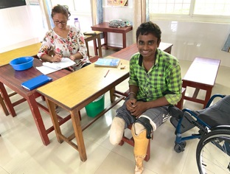
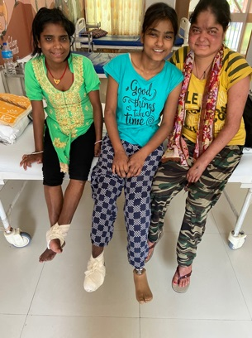
Santosh, Shova, Neelam, Ruby
Young people affected by leprosy

Slide 5
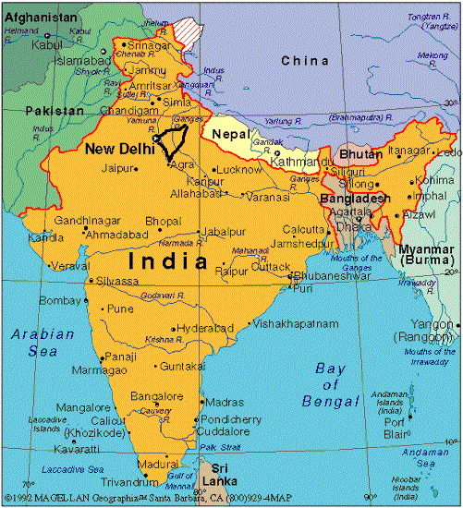
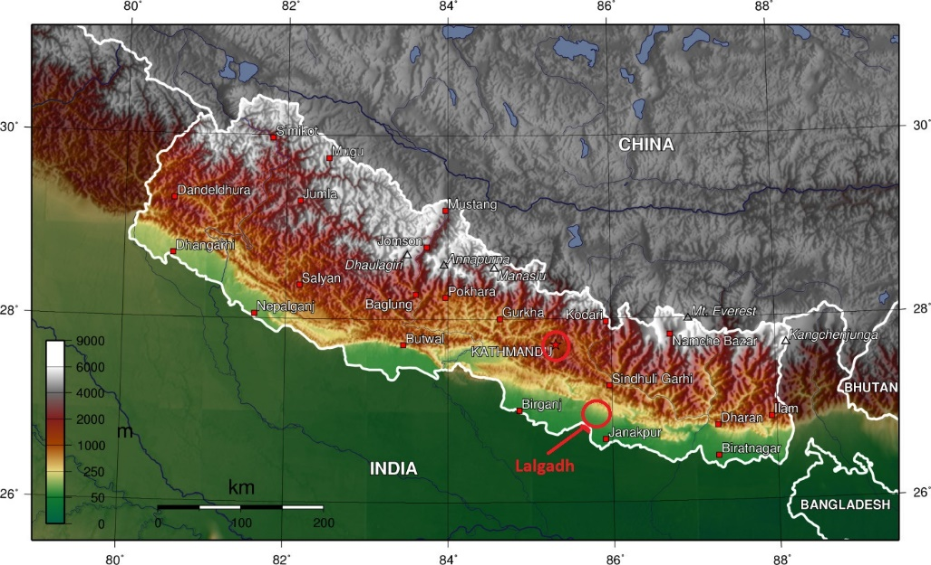
Nepal

Slide 6
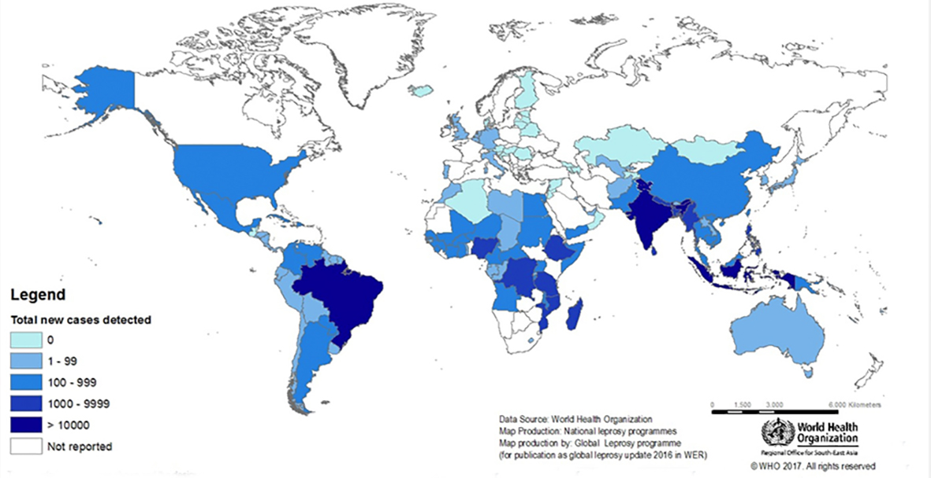
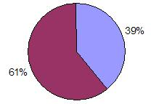
Leprosy
Leprosy is prevalent in many parts of the world – mainly in countries affected by poverty.
Nearly 200,000 cases detected each year – about 60% of those in India, Bangladesh and Nepal.

Slide 7
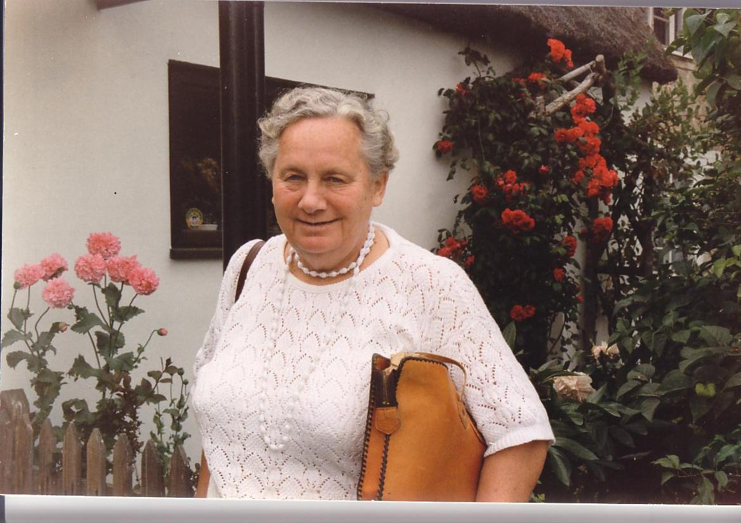
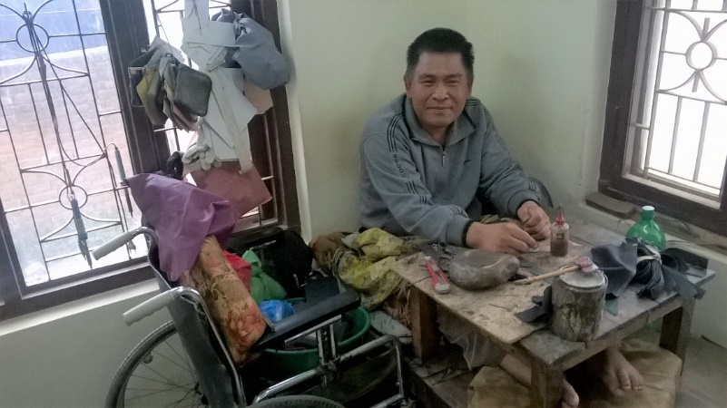
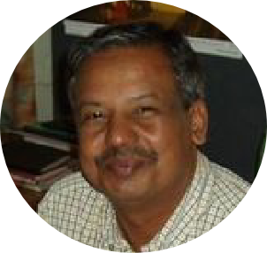
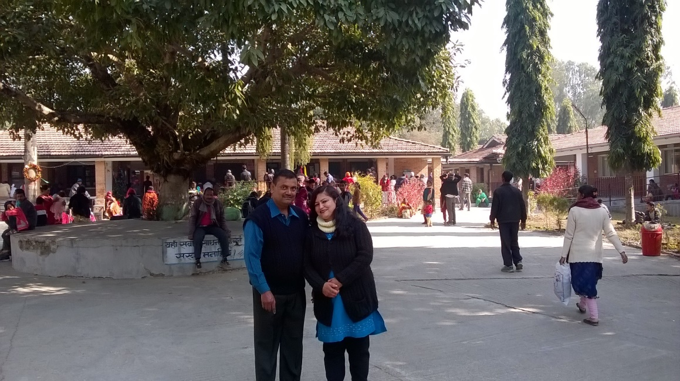
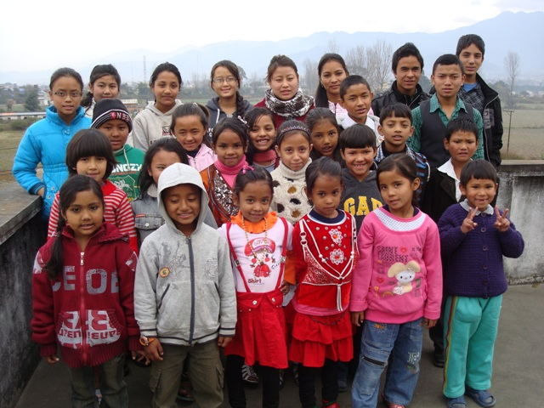
Nepal Leprosy Trust
Eileen Lodge Established
NLT in 1972
Fair Trade Workshops
CEO Kamal Shrestha
Lalgadh Leprosy Hospital and Services Centre
Lydia Children’s Fund
(Child Sponsorship)
About 40,000 individual cases of leprosy diagnosed since 1992

Slide 8
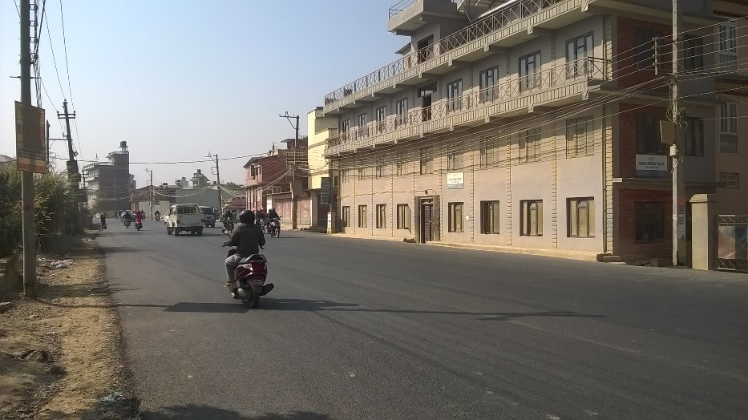
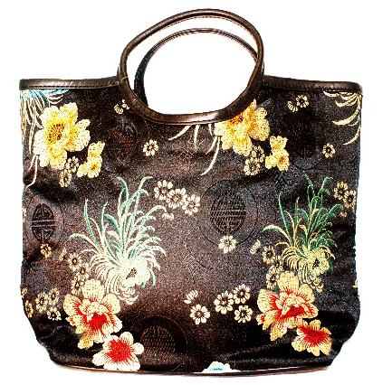
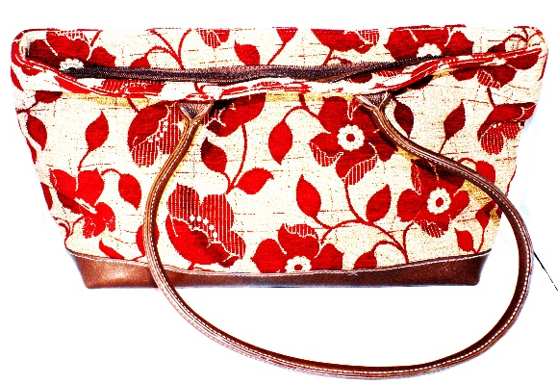
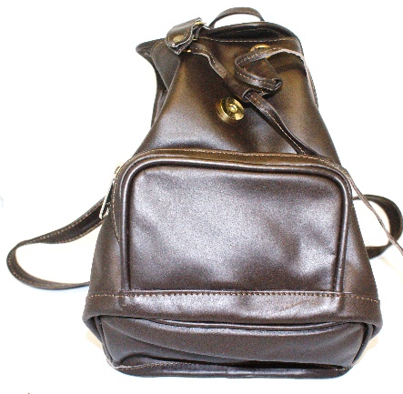
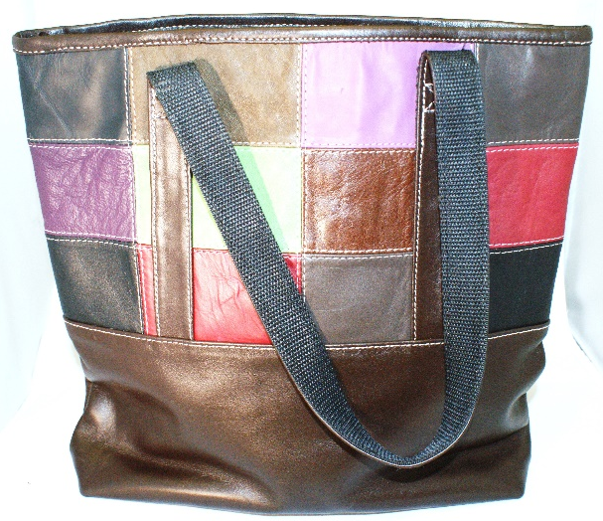
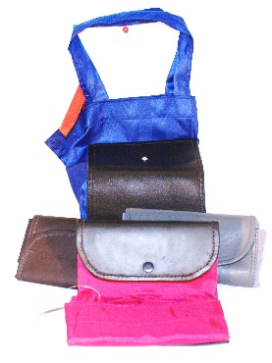
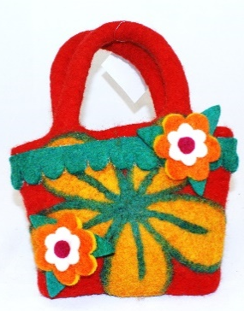
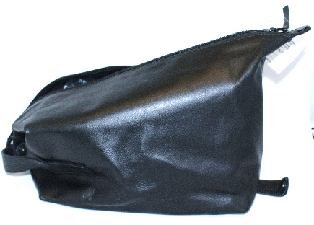
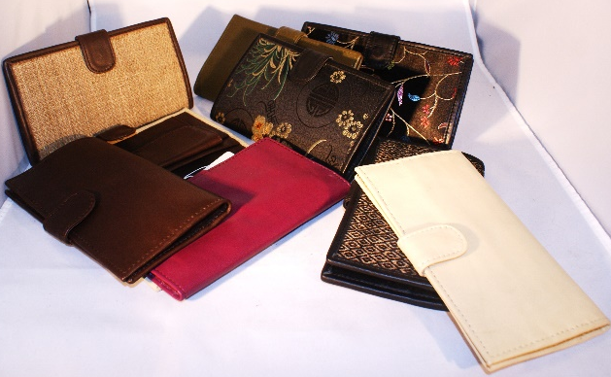
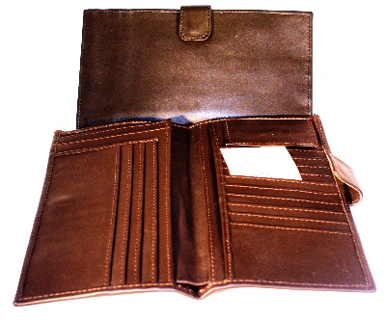
Kathmandu - Handicrafts
Kathmandu Office and workshop

Slide 9
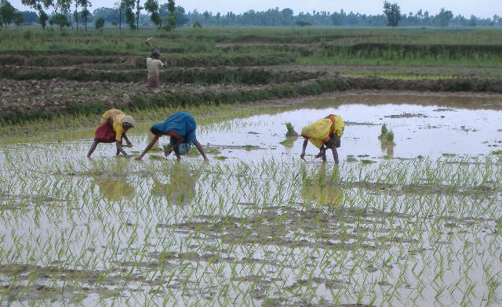
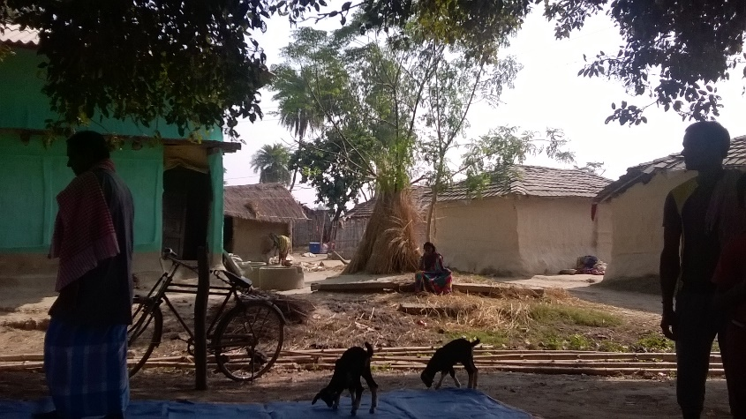
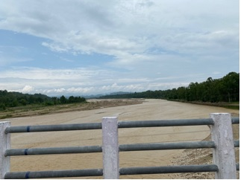
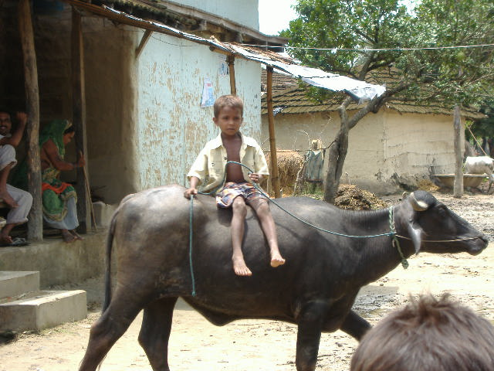
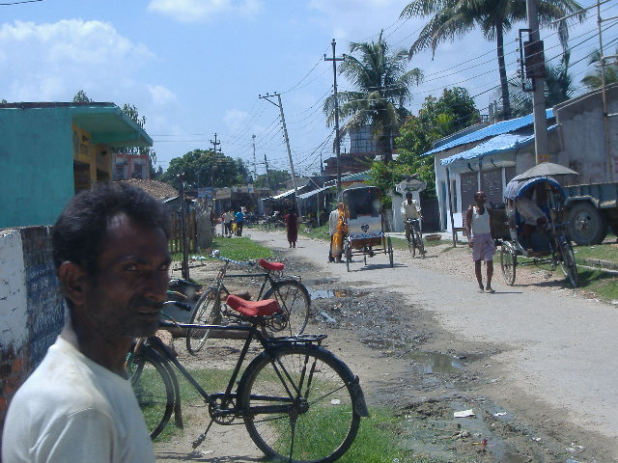
Around Lalgadh

Slide 10
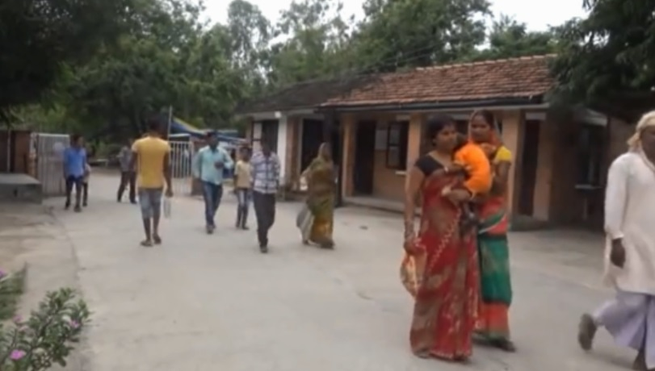
Lalgadh
Looking at the Outpatients Unit

Slide 11
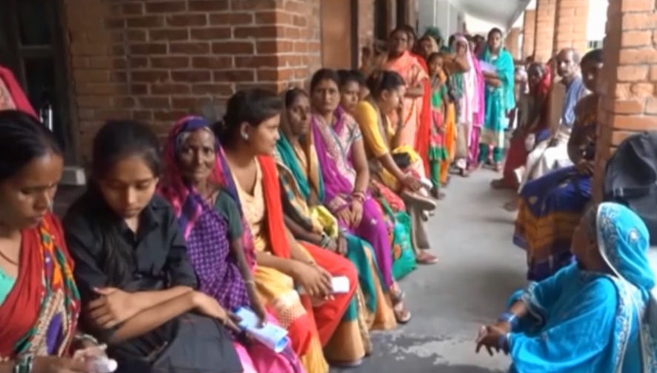
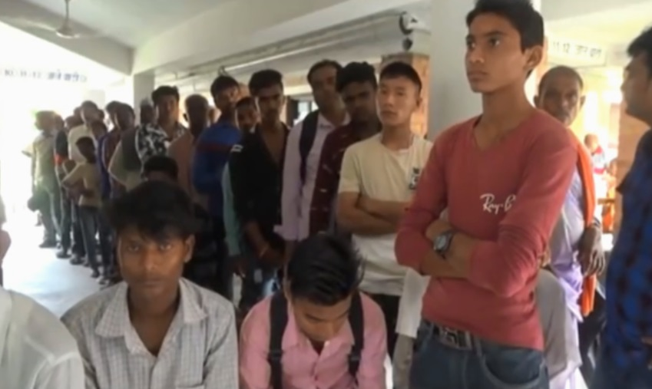
Lalgadh
Looking at the Outpatients Unit

Slide 12
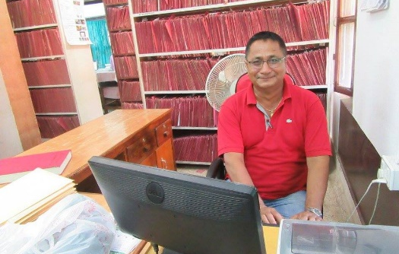
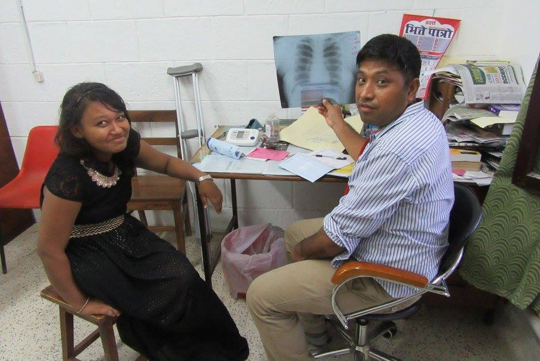
Lalgadh
Looking at the Outpatients Unit

Slide 13
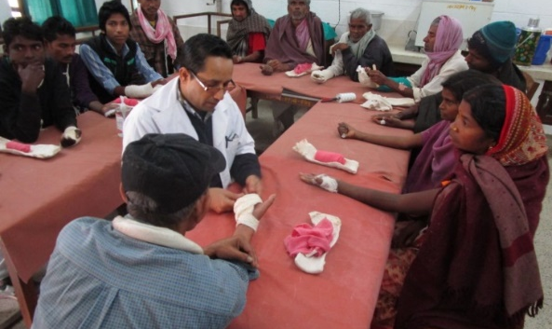
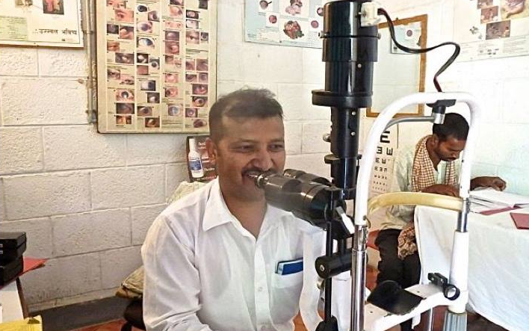
Lalgadh
Looking at the Outpatients Unit

Slide 14
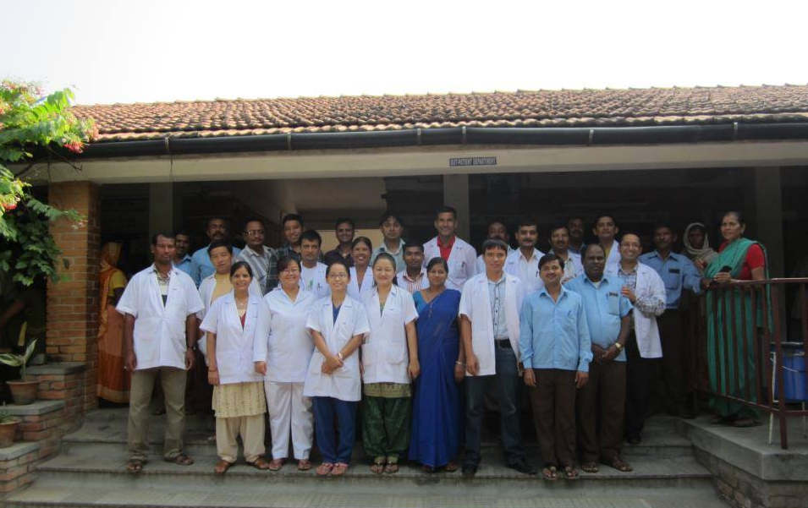
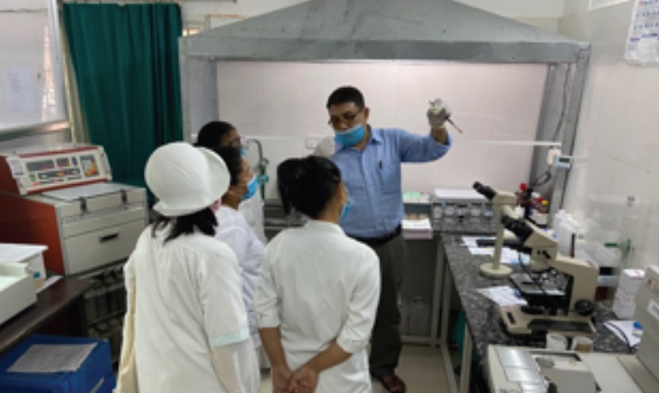
Lalgadh
Looking at the Outpatients Unit

Slide 15
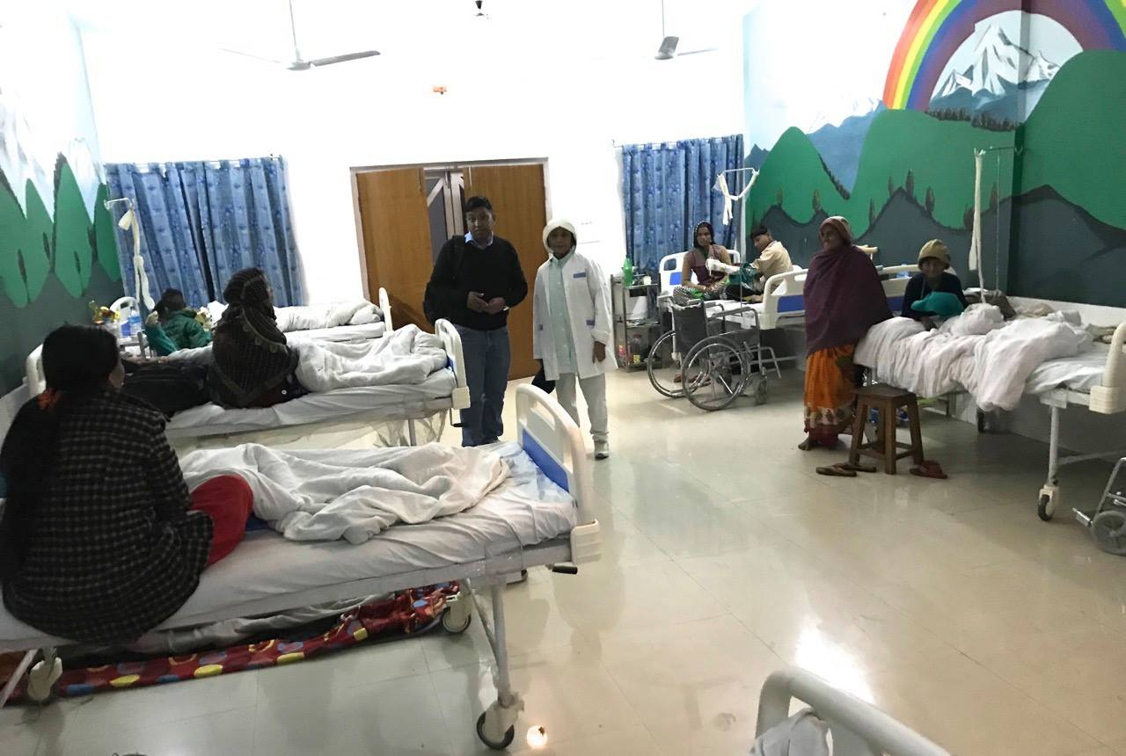
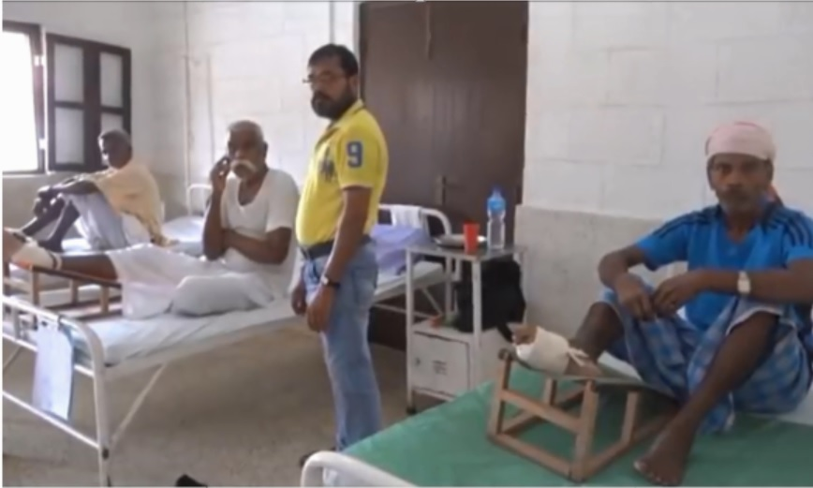
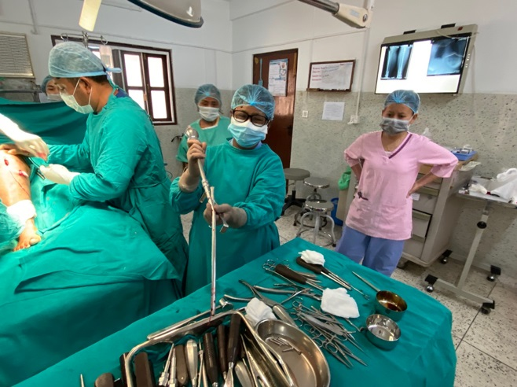
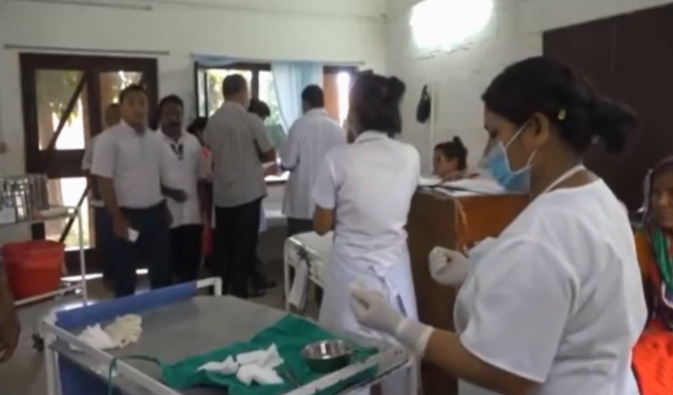
Lalgadh
Looking at the Inpatients Unit

Slide 16
Inpatients

Slide 17
Self Care Training Centre
A two week training in self care techniques
The SCTC is a vital bridge between the work inside Lalgadh and the work outside in the community
Also teaches trainees the benefits of working in groups and so links into the community work

Slide 18
Taking the work into the Community – Reducing Stigma
112 self help groups
Water projects
Savings schemes
Sanitation improvement
Income generation
Non-formal education

Slide 19
Working in Inarwaha

Slide 20
Care Haven
Lal Bahadur
Manoj

Slide 21
Lalgadh Church
Recent Christmas service
Baptisms August 2020

Slide 22
Prayer Points
For the safety of our staff during the pandemic. God has wonderfully kept them so far.
For the many needy people who have been unable to access medical support during recent months.
For NLT Nepal’s leaders and senior managers to have the wisdom they need to guide NLT through this difficult time, keeping God at the centre of it all.
For our many patients to be served with compassion and skill and to be drawn to the Gospel.
For the community work around Lalgadh – for a Christian ethos to be evident and to have impact.
For more orders for the Kathmandu workshop.
For the necessary resources to take the work through the difficulties of the pandemic, and to provide for the needs of vulnerable families affected by leprosy.
For Dr Graeme and his wife Meena to be safe and to know the Lord’s blessing on their work.
For Lalgadh Church to be salt and light to the surrounding community.

Slide 23
Beating leprosy, breaking stigma and building lives.

